Slide 1


Predicting Insurance Claims
Daniel Zheng
3 Jun 2023
For Protection, we are your best selection

Slide 2
Agenda
Business Problem
Dataset Used
Findings and Model
Conclusion
Future Work
2

Slide 3
Business and Data Science Problem

Slide 4



Business and Data Science Problem
Business Problem
Current Assumptions for managing underwriting risk, and premiums charged are uniform across all customers (eg. Discount rates, projection of expected liability cash flows)
Maximising revenue and more efficient capital allocation on a risk-based approach where possible
Data Science Problem
To predict whether customers will claim on their insurance, to better model future claims and pricing on a risk-based approach
4

Slide 5
Datasets used

Slide 6


Dataset Description
Car Statistics
Dimensions of Car (eg, height, cc, etc.)
Features of a car (eg. Gearbox, cameras, safety rating, transmission, etc.)
Dataset contains 58,592 observations (policies), and 44 columns
Columns largely relate to statistics related to policyholder and car
Policyholder Statistics
Age of Policyholder
Tenure of Policy
6
Notes:
Source: Kaggle
https://www.kaggle.com/datasets/ifteshanajnin/carinsuranceclaimprediction-classification/discussion

Slide 7
Findings and Predictive Modelling

Slide 8
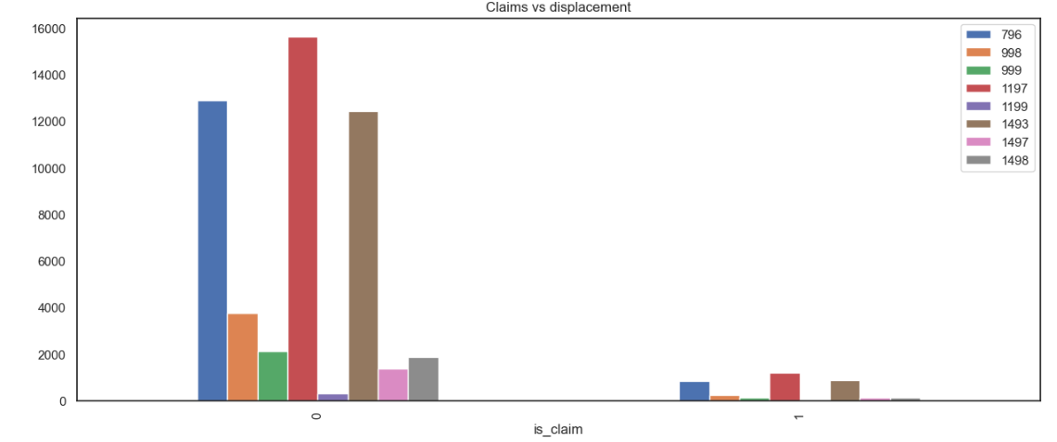
Displacement (cc)
Lower and mid-range cc cars appear to have a lower tendency to claim car insurance
8
Notes:
1. Cluster C19 appears to have a lot more people who did not claim any car insurance.
2. A lot more manual cars appear to not claim car insurance.
3. Cars in segment A, B2 and C2 have a lower tendency to claim car insurance.

Slide 9
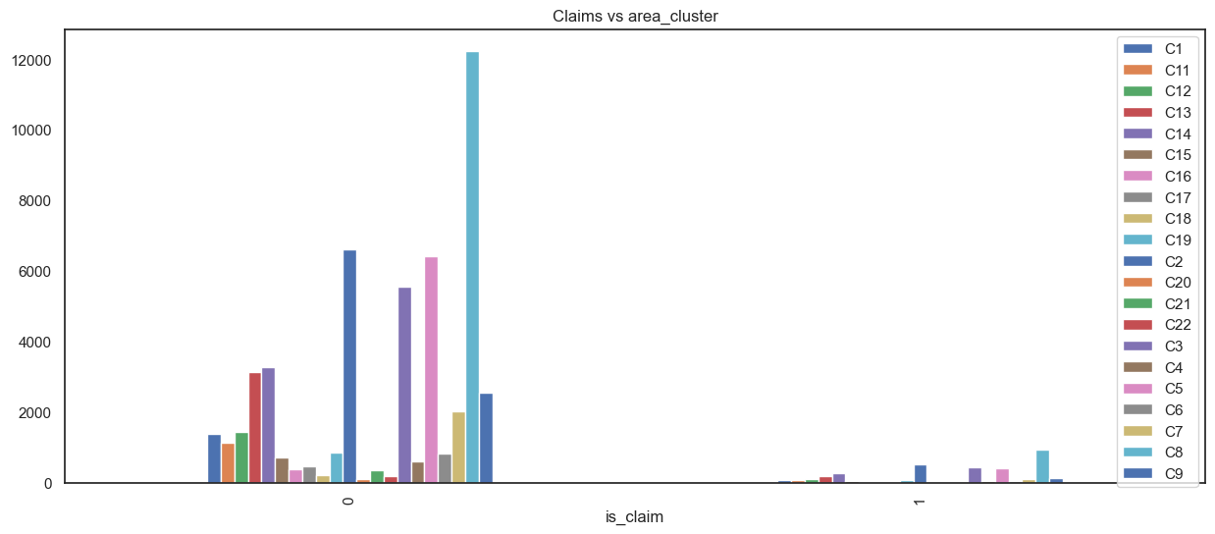
Area Clusters
Cars belong to cluster C19 appear to have a lot more people who did not claim car insurance
9
Notes:
1. Cluster C19 appears to have a lot more people who did not claim any car insurance.
2. A lot more manual cars appear to not claim car insurance.
3. Cars in segment A, B2 and C2 have a lower tendency to claim car insurance.

Slide 10
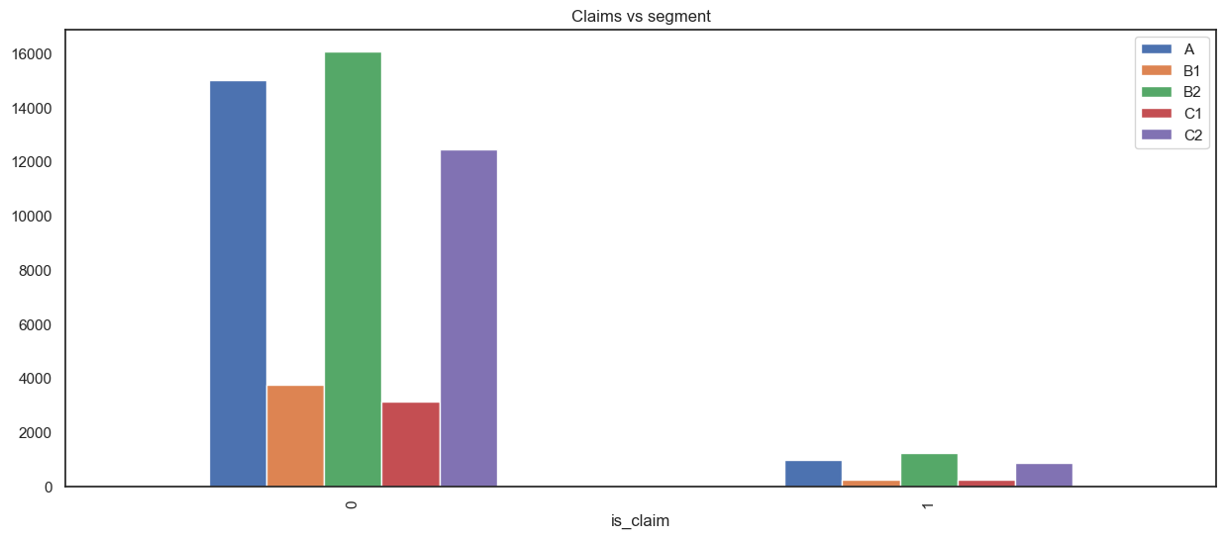
Car Segment
Cars belonging to segment A, B2 and C2 appear to have a lower tendency to claim car insurance
10
Notes:
1. Cluster C19 appears to have a lot more people who did not claim any car insurance.
2. A lot more manual cars appear to not claim car insurance.
3. Cars in segment A, B2 and C2 have a lower tendency to claim car insurance.

Slide 11
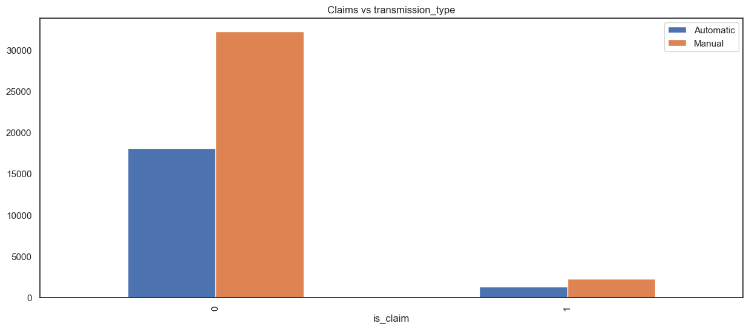
Transmission
Manual Cars appear to not claim insurance more, as compared to automatic
11
Notes:
1. Cluster C19 appears to have a lot more people who did not claim any car insurance.
2. A lot more manual cars appear to not claim car insurance.
3. Cars in segment A, B2 and C2 have a lower tendency to claim car insurance.

Slide 12
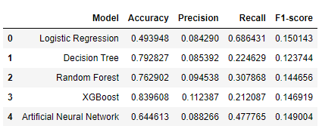
Data Modelling
First version MVP utilizes the XGBoost algorithm, given that it has the highest accuracy score and a relatively higher F1-score compared to the others. We will work towards refining the models with more data.
First version MVP: Testing Site
12

Slide 13
Conclusions and Recommendations

Slide 14


R&R: Recalibrate, and Re-adjust
Recalibrate the amount of capital allocated based on characteristics of car.
For example, we could allocate less capital for the smaller-sized cars/cc given their propensity to not claim insurance.
Other factors include the transmission type, area cluster the policyholder is in etc.
Re-adjust premiums based on the model output. For example, where customers are predicted to claim insurance, we could charge a higher premium to help cover our potential losses.
Potential cost savings of about 5-15%, with a corresponding increase in revenue of about 10%, as per estimates
14

Slide 15
Future Work

Slide 16


Future Work
Obtaining more data in terms of demographics of policyholders (eg. Income, job, traffic accident history, history of claims, medical records etc.) to augment the model
Expand scope to improve pricing decisions. The model today classifies whether the policyholder will claim, but there is potential to look into the actual amounts of claims to better manage underwriting risk and make better decisions.
16
2

Slide 17
Thank you!
Q&A
For Protection, we are your best selection

